Slide 1

EECS 482
Lab 7: Virtual Memory 1

Slide 2
Agenda
Memory Management
Page Addressing
Clock Algorithm
Project 3
Goal: Help you start P3

Slide 3
Virtual memory: address independence
Problem: we want address independence
// Process 1
char *mymem = (char*) 0x000482;
strcpy(mymem, "process 1 rules");
// Process 2
char *mymem = (char*) 0x000482;
strcpy(mymem, "process 2 rules");
Process 1's mymem should not point to the same physical memory as Process 2's mymem.

Slide 4
Virtual memory: address independence
A solution is to use virtual memory.
Each process has its own virtual memory space
Each process has some mapping from virtual address to physical address.
P1 memory space:
Physical memory:
0x000482
0x001
P2 memory space:
0x000482
0x005
P3 memory space:
0x006
0x000482

Slide 5
How to do address translation?
A few approaches:
Base and Bound
Segmentation
Paging

Slide 6
Base and bound
Base: starting physical address
Bound: size of region
Translate memory accesses based on base
Cons:
Virtual memory can’t be bigger than physical memory
Can't share only part of an address space
Copying entire address spaces is slow
External fragmentation
P1
P3
(disk)
P2

Slide 7
Segmentation
Each process’ address space split into segments
Improvements:
Can share a single segment between processes
Don’t have to copy in/out entire address spaces
Cons:
Each segment still can’t be larger than physical memory
Still external fragmentation
P1 (code)
P2 (data)
P2 (code)
P1 (stack)
P1 (data)
P2 (stack)

Slide 8
Address Translation - Paging:
Virtual address
Virtual page num
Offset
Each process has a page table.
Translate the VPN to a PPN and keep the offset.
When a different process runs, swap to its page table.
VPN
PPN
0
22
1
23
Page table
2
16
...
...
31
4
Physical page num
Offset
Physical address

Slide 9
Paging
P2
P1
Location | Page Num
 | 0
 | 1
 | 2
 | 3
 | 4
P1
Page Num | Location
0
1
2
3
4
P2
P2
P1
P2
P1
P1
P2
P1
P2
Physical Memory
Disk

Slide 10
Paging: read and write enable
Virtual address
Virtual page num
Offset
Page table stores r/w bits.
These inform the MMU whether or not to fault on an access.
Page table
VPN
PPN
r
w
0
22
1
1
1
??
0
0
2
16
1
0
...
...
...
...
Disk
Physical page num
Offset
Physical address

Slide 11
Paging: the MMU
Virtual address
Virtual page num
Offset
MMU = memory management unit.
On every load or store, checks the read or write bit for that page.
If the corresponding bit is not enabled, triggers a fault.
Faults handled by the operating system (the pager).
Page table
VPN
PPN
r
w
0
22
1
1
1
??
0
0
2
16
1
0
...
...
...
...
Physical page num
Offset
Physical address

Slide 12
Lab Questions (Memory Management 1)

Slide 13
Question 1
Assume one-level paging with 32-bit addresses and 4KB pages:
How many bits are needed to represent the offset?
How many bits are needed to represent the page number?
What is the greatest number of virtual pages a process could address?

Slide 14
Question 1
Assume one-level paging (32 bit) with 16KB pages:
How many bits are needed for the offset?
How many bits will represent the page number?
How many pages is this?

Slide 15
Review: Clock Replacement Policy
Examine pages in clockwise order. For each page:
If the page is referenced, mark it unreferenced
If the page is unreferenced, evict it
New pages are added behind the clock hand

Slide 16
Question 2
Assume the clock queue contains the following resident pages
3
5
7
6
0
1
2
4

Slide 17
Question 2
Given this clock state, which page will be evicted next?
R
R
3
R
5
7
6
0
R
1
2
R
4

Slide 18
Extra Exercise
Given this clock state, which page will be evicted next?
R
R
3
R
5
7
R
6
0
R
1
2
R
R
4
R

Slide 19
Project 3

Slide 20
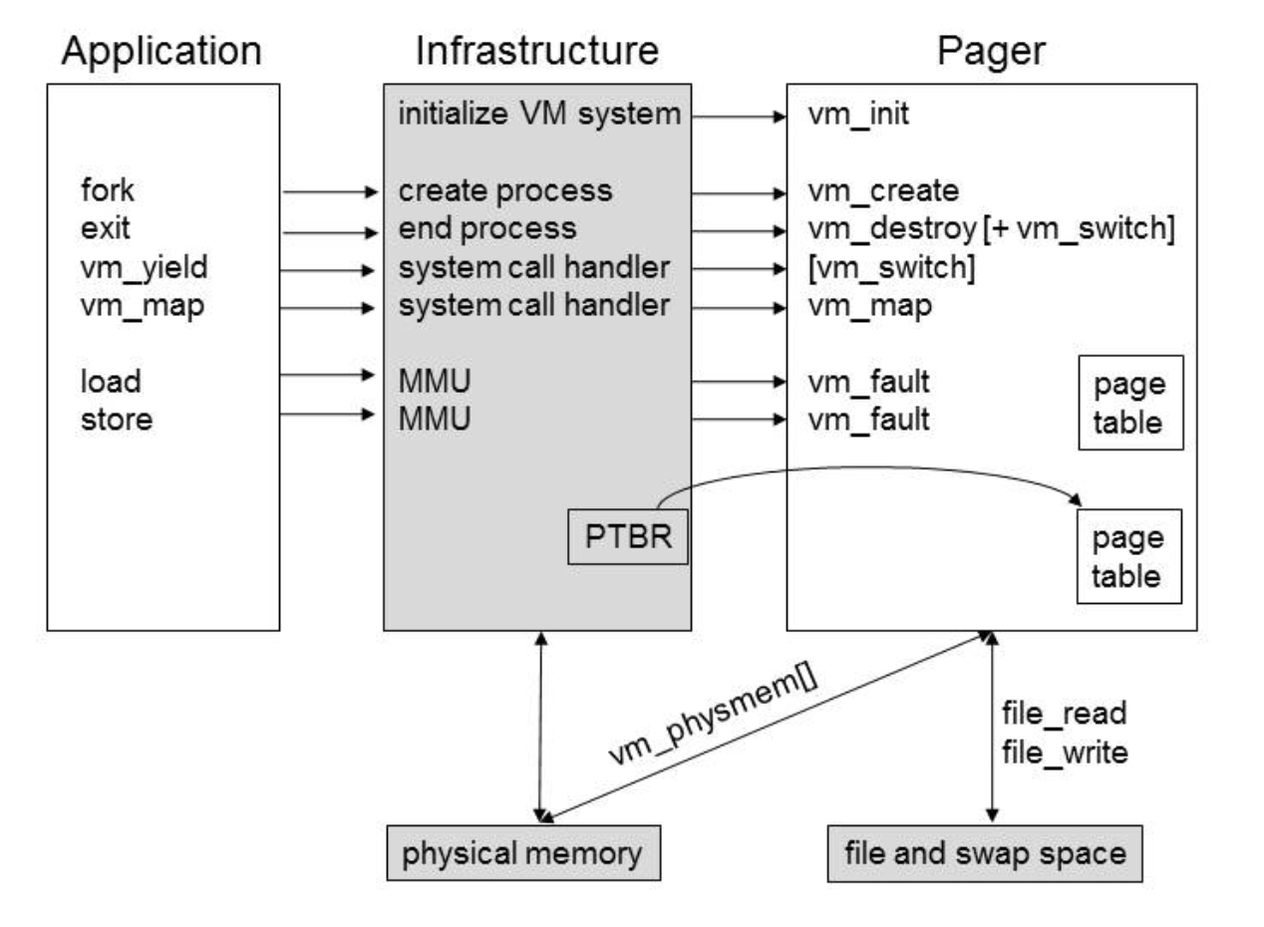
Project 3 basic infrastructure

Slide 21
Project 3 basic infrastructure
The user writes some application.

Slide 22
Project 3 basic infrastructure
The user writes some application.
User links their application with libvm_app.o
Now the infrastructure can intercept all these actions.

Slide 23
Project 3 basic infrastructure
The user writes some application.
User links their application with libvm_app.o
The infrastructure implements the MMU.
On every load and store, the MMU runs.

Slide 24
Project 3 basic infrastructure
The user writes some application.
User links their application with libvm_app.o
The infrastructure implements the MMU.
MMU uses the page table pointed to by PTBR.
Your pager stores the page table(s)

Slide 25
Project 3 basic infrastructure
The user writes some application.
User links their application with libvm_app.o.
The infrastructure implements the MMU.
MMU uses the page table pointed to by PTBR.
All user loads and stores read and write to physical memory.
This is an array stored by the infrastructure.

Slide 26
Project 3 basic infrastructure
Your pager runs as a separate process.

Slide 27
Project 3 basic infrastructure
Your pager runs as a separate process.
Your pager stores a page table per user process.

Slide 28
Project 3 basic infrastructure
Your pager runs as a separate process.
Your pager stores a page table per user process.
The infrastructure hooks into your pager.
It expects the pager to be running when the user application starts.

Slide 29
Project 3 basic infrastructure
Your pager runs as a separate process.
Your pager stores a page table per user process.
The infrastructure hooks into your pager.
Your pager must update the PTBR to point to one of your page tables.
So the MMU can translate reads/writes.

Slide 30
Project 3 basic infrastructure
Your pager runs as a separate process.
Your pager stores a page table per user process.
The infrastructure hooks into your pager.
Your pager must update the PTBR to point to one of your page tables.
MMU triggers vm_fault on a read/write fault.
i.e., if the given page table entry for a given load/store is not read/write enabled.

Slide 31
Project 3 basic infrastructure
page_table_entry_t contains flags needed for infrastructure (MMU) to do its translation.
page_table_t contains an array of page_table_entry_t, one for each page in the process’ arena.
struct page_table_entry_t {
unsigned int ppage : 20; /* bit 0-19 */
unsigned int read_enable : 1; /* bit 20 */
unsigned int write_enable : 1; /* bit 21 */
};
struct page_table_t {
page_table_entry_t ptes[VM_ARENA_SIZE/VM_PAGESIZE];
};

Slide 32
Project 3 basic infrastructure
When a process wants to read/write a page, the infrastructure checks the read_enable/write_enable flag.
If it is enabled, the infrastructure uses the page table (pointed to by PTBR) to translate the process’ virtual address into a physical address.
If it is disabled, the infrastructure calls vm_fault, which should do the work to make the page accessible. After vm_fault returns, the infrastructure tries to access the page again.

Slide 33
MMU (resident page)
2
3
page_table_entry_t
Check read_enable
bit
ppage = 3
read_enable = 1
write_enable = 0
MMU finds corresponding
page_table_entry_t
1
Process P1 requests read to address x
4
Access page 3 of physical mem
P1’s page_table_t

Slide 34
MMU
3
page_table_entry_t
2
Check write_enable
bit
ppage = 3
read_enable = 1
write_enable = 0
MMU finds corresponding
page_table_entry_t
1
Process P1 requests write to
address x
4
Call vm_fault(x, true)
5
Recheck the page_table_entry_t
and try to reaccess the page
P1’s page_table_t

Slide 35
vm_fault
Important questions to get you off the ground:
When does vm_fault get called?
Can you control when vm_fault gets called?
What is the purpose of a vm_fault call?

Slide 36
Swap-Backed vs File-Backed Pages
A swap-backed virtual page is backed by the swap file
when it gets evicted, it goes to a block in the swap file
all processes share the same swap file
a swap-backed page is private to a process
when a process forks, swap-backed pages should still appear to be private to a process, but the work of copying them should be deferred (copy-on-write)
A file-backed virtual page is backed by a regular file
when it gets evicted, it goes back to a specific block in the corresponding file
different processes can share the same file-backed virtual page

Slide 37
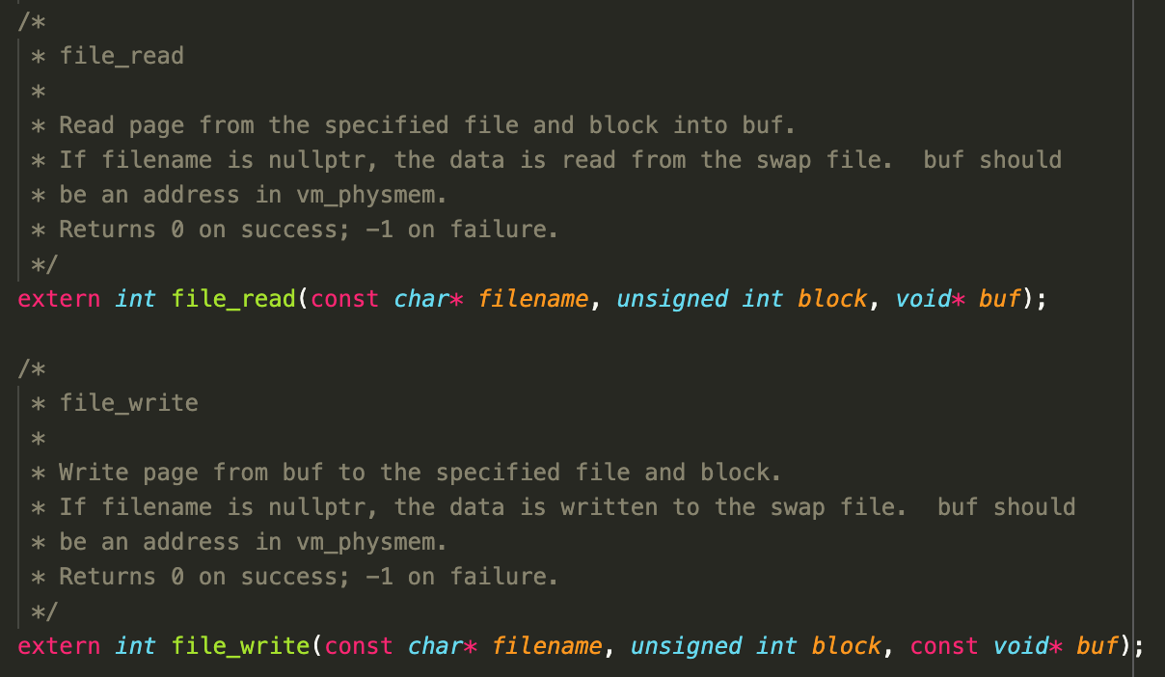
file_read and file_write
Implemented by the infrastructure
Headers in vm_pager.h
Use these functions to interact with the disk
Pass nullptr for the filename to read/write to swap blocks
You can check whether the read/write was successful by looking at the return value

Slide 38
Eager Swap Reservation

Slide 39
Eager Swap Reservation
Goal: the pager should always be able to evict a swap-backed page.
Return error if processes try to allocate too many swap-backed pages.
When/where do we have to detect this?
Notes:
vm_fault, vm_create 6 credit

Slide 40
Eager Swap Reservation
vm_physmem
swapfile
process 6
zero-filled
swap-backed
shakespeare.txt
0
swap-backed
swap-backed
Is this valid?
yes
shakespeare.txt
1
swap-backed
swap-backed

Slide 41
Eager Swap Reservation
vm_physmem
swapfile
vm_map(nullptr, ...)
process 6
zero-filled
swap-backed
shakespeare.txt
0
swap-backed
swap-backed
Is this valid?
no
shakespeare.txt
1
swap-backed
swap-backed

Slide 42
Eager Swap Reservation
vm_physmem
swapfile
process 6
zero-filled
swap-backed
shakespeare.txt
0
process 7
swap-backed
swap-backed
Is this valid?
no
shakespeare.txt
1
swap-backed
vm_create(6,7)
swap-backed

Slide 43
State Diagrams

Slide 44
Project 3 State Diagrams
Drawing a state diagram will help you understand the lifetime of a virtual page
You need to reason about what functionality you have to implement before writing the code
There's less of a chance you have to rewrite a large portion of your project
It helps keep you focused while writing code
Draw separate state diagrams for swap-backed and file-backed pages
Some states are valid for one but not the other
It helps identify conceptual differences between the two

Slide 45
Project 3 State Diagrams
Step 1: what states can a page be in?
For every combination of read_enable and write_enable
is this combination possible?
what states could the page be in for these bits to be set?
Consider the entire lifetime of the page starting from before it is mapped to when it is destroyed

Slide 46
Project 3 State Diagrams
Step 2: what information do you need to track for each page?
What information can you track to determine which state a page is in?
What information determines if a page is read enabled?
What information determines if a page is write enabled?
Write out the values in each state
read_enable=?
write_enable=?
resident=?
…

Slide 47
Project 3 State Diagrams
Step 3: what events transition a page between states?
What are all the events that can affect the state of a page?
read fault
write fault
…
For every state, consider each event
is the event possible in this state?
which state will the page transition to?

Slide 48
Example formatting for a state diagram
S2
S4
Read
Eviction
Resident=0
...
Read_enable =0
Write_enable=1
(not a real state)
Write
…
S3
S5
S1

Slide 49
Recommendations
Don’t hard-code states and transitions; this leads to repetitive and unintuitive code
The state diagram is mainly meant to help you understand the concepts, not for you to directly translate to code
Instead, generalize what happens to pages for each transition
For example, what happens to a page *in general* when it is read?

Slide 50
An example of what not to do
if (state 1) {
if (read) {
Goto state 2
} else if (write) {
Goto state 3
} else if (evict) {
Stay in state 1
}
}
else if (state 2) {
if (read) {
Stay in state 2
} else if (write) {
Goto state 3
} else if (evict) {
Goto state 1
}
} …

Slide 51
Recommendations
This is a project where it is beneficial to design the complete system before you write any code
Aim for clear abstractions representing the various entities, with crisp interfaces between them
It may take several iterations to get a "good" design, and sometimes you can't really tell that a design is not "good" until you are partway through coding it
Therefore, do not be shy about starting over from a clean sheet
It can often be faster to start over with a better design than to try to get an existing architecture to work
Focus on having clear notions of ownership and responsibility
Notes:
bnoble added this to F22 spec. I think this is good advice that should be given to students up front (but reiterated later in the P3 lifecycle)

Slide 52
Recommendations
Design data structures/classes before coding
Does your design cleanly support sharing of pages?
If an "entity" has different items/attributes, make it a class/struct
Implement the project incrementally
Start with swap-backed pages
Then add file-backed pages
Then work on fork
It is very difficult to wrap your mind around P3 concepts
Start Early. Read the spec over and over and over again

Slide 53
Questions?

Slide 54
Bonus Review (Multi-level Paging)

Slide 55
Review: multi-level paging
Single level page table takes a lot of memory.
Multi-level paging to the rescue!
L1
Where do the memory savings come from?
L2

Slide 56
Review: multi-level paging
Virtual address
L1 index
L2 index
Offset
L1 Page Table
VPN
L2
0
1
L2 Page Table
VPN
PPN
0
30
1
186
Physical address
Physical page num
Offset

Slide 57
Question 2
mprotect() is a function that controls how a section of memory may be accessed (see the mprotect manual page for more information).
int mprotect(void *addr, size_t len, int prot)

Slide 58
Question 2
int mprotect(void *addr, size_t len, int prot)
To check whether the calling procedure invoked mprotect() with addr and len in the arena, one might write:
if (addr < beginArena || addr+len > endArena) {
return -1;
}
Are the above checks sufficient?

Slide 59
Question 2
Doesn’t account for fact that addr+len might overflow. For example:
addr = 0x60002000
len = 0xffffffff
addr + len = 0x60001fff < end of arena

Slide 60
Question 2
if (addr < beginArena || addr+len > endArena) {
return -1;
}
Fix - add third error check
if (addr < beginArena || addr+len > endArena || addr+len < addr) {
return -1;
}

